Slide 1
Data Quality and Metrics
IS465: Data Management and Governance

Slide 2
Outline
Introduction to Data Quality
Data Quality Dimensions
Data Quality Metrics
Data Quality Assessment
Data Quality Improvement
Data Cleansing and Normalization Techniques

Slide 3
Introduction to Data Quality

Slide 4

Ensuring Trustworthy Data for Informed Decision Making
Data quality is a critical aspect of any organization's data management strategy.

Slide 5

What is Data Quality?
Data quality refers to the degree to which data is accurate, complete, consistent, and reliable, and meets the requirements of its intended use
Data quality is a multifaceted concept that encompasses various aspects of data, including accuracy, completeness, consistency, and reliability.

Slide 6
Why is Data Quality Important?
Informed decision making
Operational efficiency
Customer satisfaction
Competitive advantage
Regulatory compliance

Slide 7
The Cost of Poor Data Quality
Inaccurate decisions
Financial losses
Reputational damage
Decreased customer trust
Compliance issues

Slide 8
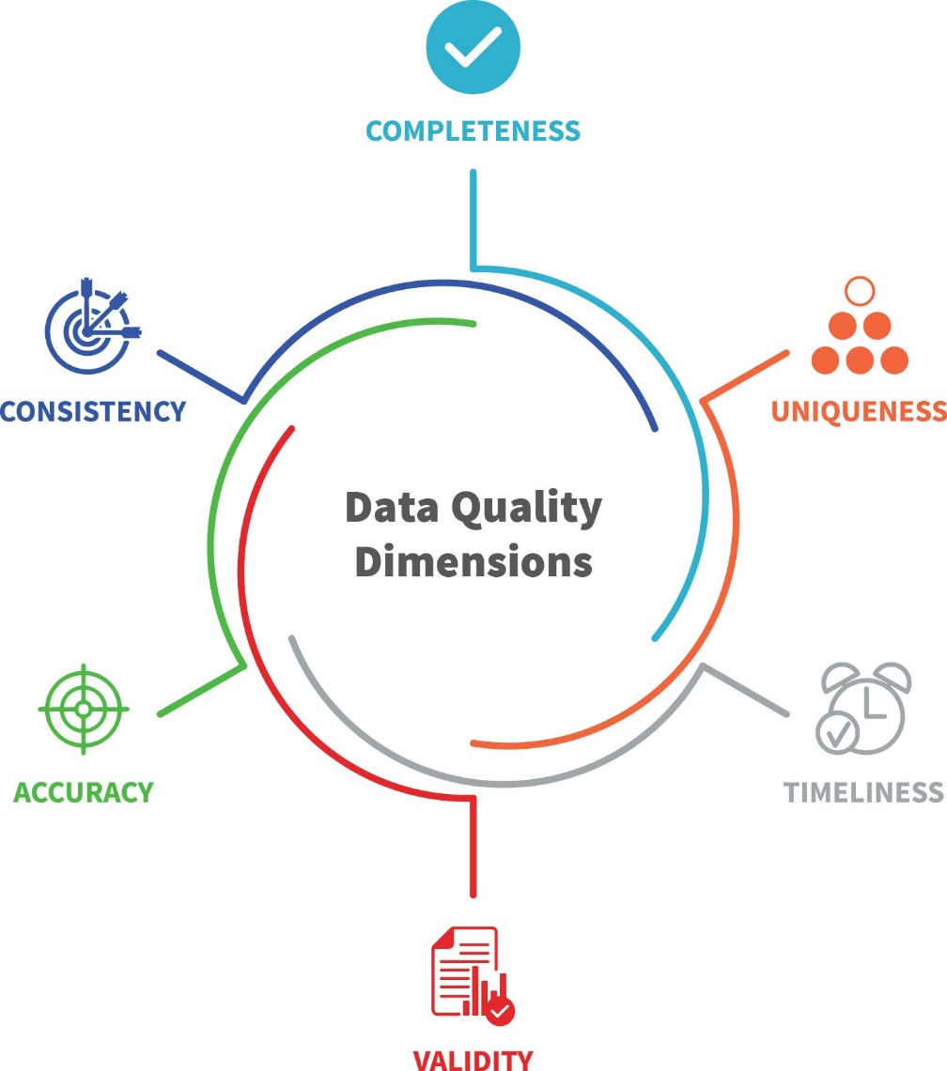
Data Quality Dimensions

Slide 9
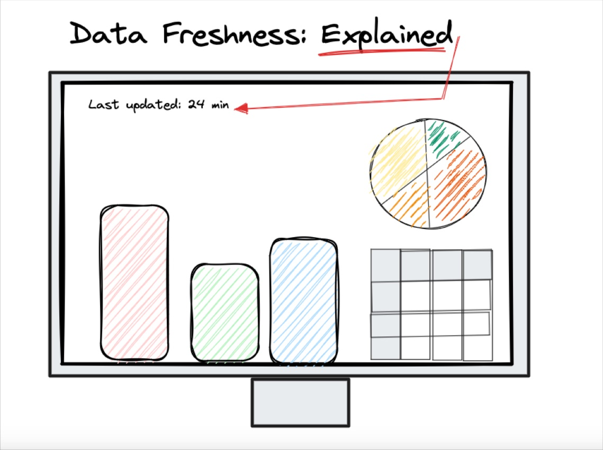
Data Quality Metrics
Error rate
Data freshness
Data coverage
Data consistency ratio
Data accuracy ratio

Slide 10
Data Quality in a Nutshell
Data quality is critical for informed decision making
Poor data quality has severe consequences
Data quality can be measured across various dimensions
Data quality metrics provide a way to quantify data quality

Slide 11
Data Quality Dimensions

Slide 12
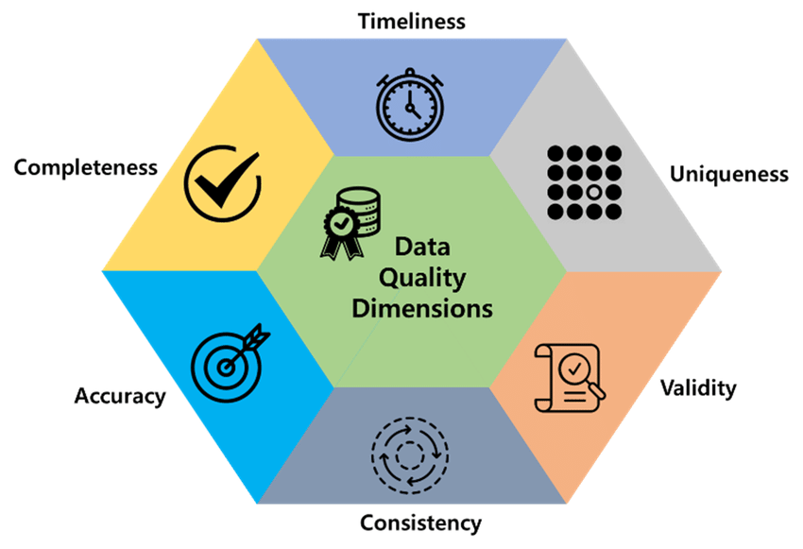
Measuring the Quality of Your Data
Data quality dimensions provide a framework for measuring and improving the quality of your data.

Slide 13

Accuracy
The correctness of data values, ensuring that they reflect the real-world values they represent.
Example: "Correct addresses, phone numbers, and dates of birth”
Accuracy is critical in ensuring that data is reliable and trustworthy.

Slide 14
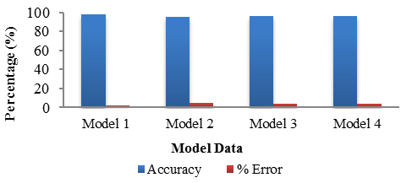
Accuracy Metrics
Accuracy metrics provide a way to measure and quantify the correctness of data values.
Accuracy rate: percentage of correct data values
Error rate: percentage of incorrect data values
Precision: degree of accuracy in data values

Slide 15

Completeness
The presence of all required data values, ensuring that no essential information is missing.
Example: "All fields filled in a form, complete customer information"
Completeness is essential in ensuring that data is comprehensive and usable.

Slide 16
Completeness Metrics
Completeness metrics provide a way to measure and quantify the presence of all required data values.
Completeness rate: percentage of complete data records
Missing value rate: percentage of missing data values

Slide 17

Consistency
The uniformity of data values across different systems or sources, ensuring that data is presented in a consistent format.
Example: "Consistent formatting of dates, consistent use of abbreviations"
Consistency is critical in ensuring that data is easily interpretable and comparable.

Slide 18
Consistency Metrics
Consistency metrics provide a way to measure and quantify the uniformity of data values.
Consistency rate: percentage of consistent data values
Inconsistency rate: percentage of inconsistent data values

Slide 19
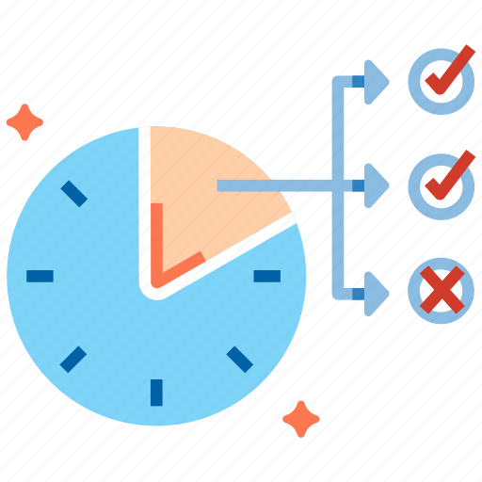
Timeliness
The currency of data values, ensuring that data is up-to-date and reflects the current state of the real world.
Example: "Up-to-date customer information, current product prices”
Timeliness is essential in ensuring that data is relevant and actionable.

Slide 20
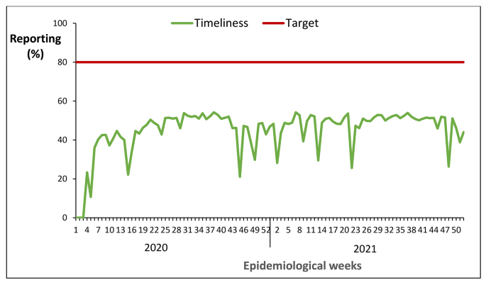
Timeliness Metrics
Timeliness metrics provide a way to measure and quantify the currency of data values.
Timeliness rate: percentage of up-to-date data values
Staleness rate: percentage of outdated data values

Slide 21
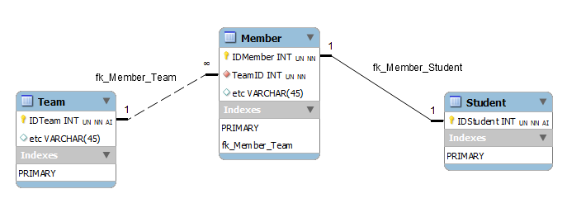
Uniqueness
The absence of duplicate data values, ensuring that each data record is unique and distinct.
Example: "No duplicate customer records, unique product IDs"
Uniqueness is critical in ensuring that data is accurate and reliable.

Slide 22
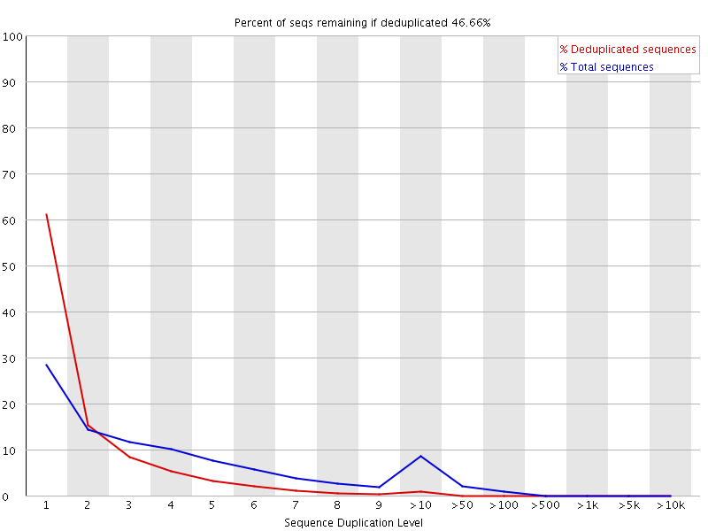
Uniqueness Metrics
Uniqueness metrics provide a way to measure and quantify the absence of duplicate data values.
Uniqueness rate: percentage of unique data records
Duplication rate: percentage of duplicate data records

Slide 23
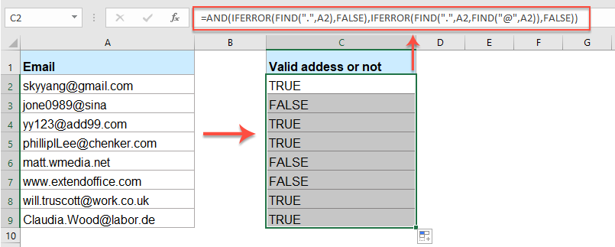
Validity
The adherence of data values to defined rules and constraints, ensuring that data is correct and meaningful.
Example: "Valid email addresses, correct formatting of phone numbers"
Validity is essential in ensuring that data is reliable and trustworthy.

Slide 24
Validity Metrics
Validity metrics provide a way to measure and quantify the adherence of data values to defined rules and constraints.
Validity rate: percentage of valid data values
Invalidity rate: percentage of invalid data values

Slide 25
Data Quality Dimensions Summary
Accuracy: correctness of data values
Completeness: presence of all required data values
Consistency: uniformity of data values
Timeliness: currency of data values
Uniqueness: absence of duplicate data values
Validity: adherence to defined rules and constraints

Slide 26
Data Quality Metrics

Slide 27
Measuring the Quality of Your Data
Data quality metrics provide a way to measure and quantify the quality of your data
Metrics:
Quantitative
Qualitative, and
Composite metrics

Slide 28
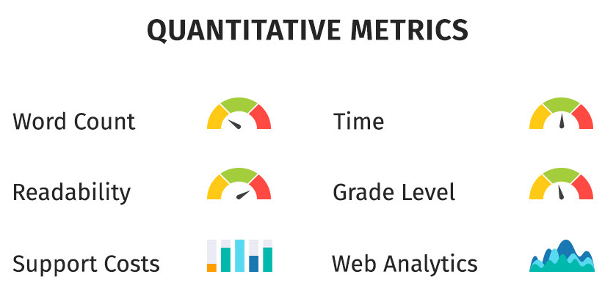
Quantitative Metrics
Quantitative metrics provide a clear and objective measure of data quality, allowing for easy comparison and tracking over time.
Numerical measures of data quality, providing a precise and objective assessment of data quality.
Examples:
Accuracy rate
Completeness rate
Error rate
Data freshness

Slide 29
Quantitative Metrics Examples
Accuracy rate: percentage of correct data values
Completeness rate: percentage of complete data records
Error rate: percentage of incorrect data values
Data freshness: percentage of up-to-date data values

Slide 30
Qualitative Metrics
Descriptive measures of data quality, providing a subjective assessment of data quality.
Examples:
Data relevance
Data consistency
Data usability
Data freshness

Slide 31
Qualitative Metrics Examples
Data relevance: how well the data meets the needs of its intended use
Data consistency: how well the data conforms to a standard or format
Data usability: how easy the data is to use and understand
Data freshness: how up-to-date the data is

Slide 32
Composite Metrics
Combinations of multiple metrics to provide a comprehensive view of data quality.
Composite metrics provide a comprehensive view of data quality, taking into account multiple aspects of data quality
Examples:
Data quality score
Data health index
Data fitness score

Slide 33
Composite Metrics Examples
Data quality score: a weighted average of multiple metrics
Data health index: a composite metric that takes into account multiple aspects of data quality
Data fitness score: a metric that assesses the overall fitness of the data for its intended use

Slide 34
Benefits of Data Quality Metrics
Improved data quality
Increased confidence in data-driven decisions
Better data management and governance
Enhanced data analytics and insights

Slide 35
Challenges of Data Quality Metrics
Defining and selecting relevant metrics
Collecting and analyzing data
Interpreting and communicating results
Maintaining and updating metrics over time

Slide 36
Data Quality Assessment

Slide 37
Evaluating the Quality of Your Data
Data quality assessment is the process of evaluating the quality of your data to identify issues and opportunities for improvement.
Data profiling
Data auditing
Data validation
Data quality dashboards

Slide 38

Data Profiling
Analysis of data distribution, patterns, and relationships to identify quality issues.
Data profiling provides a detailed understanding of the data, helping to identify quality issues and opportunities for improvement.
Examples:
Analyzing data distribution to identify outliers
Identifying patterns in data to detect anomalies
Examining relationships between data elements to identify inconsistencies

Slide 39
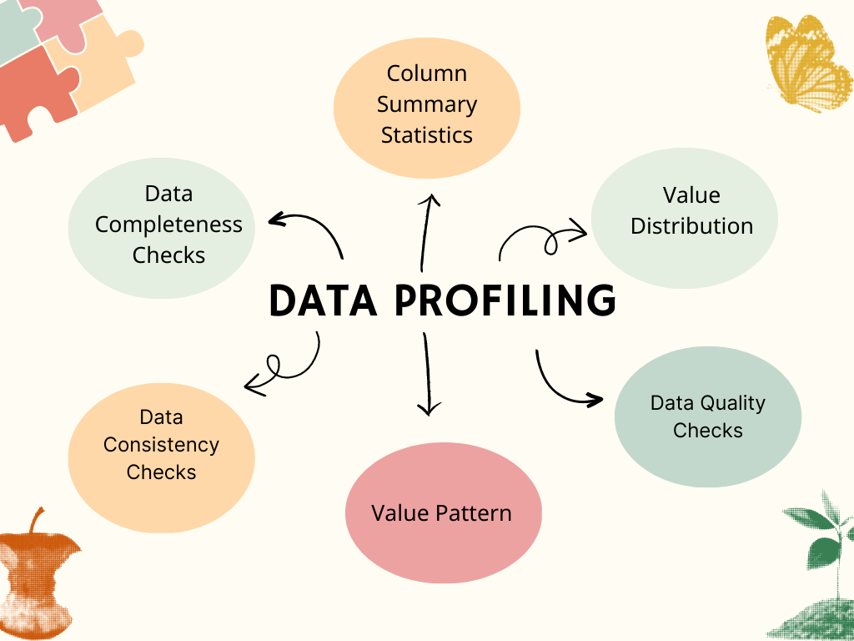
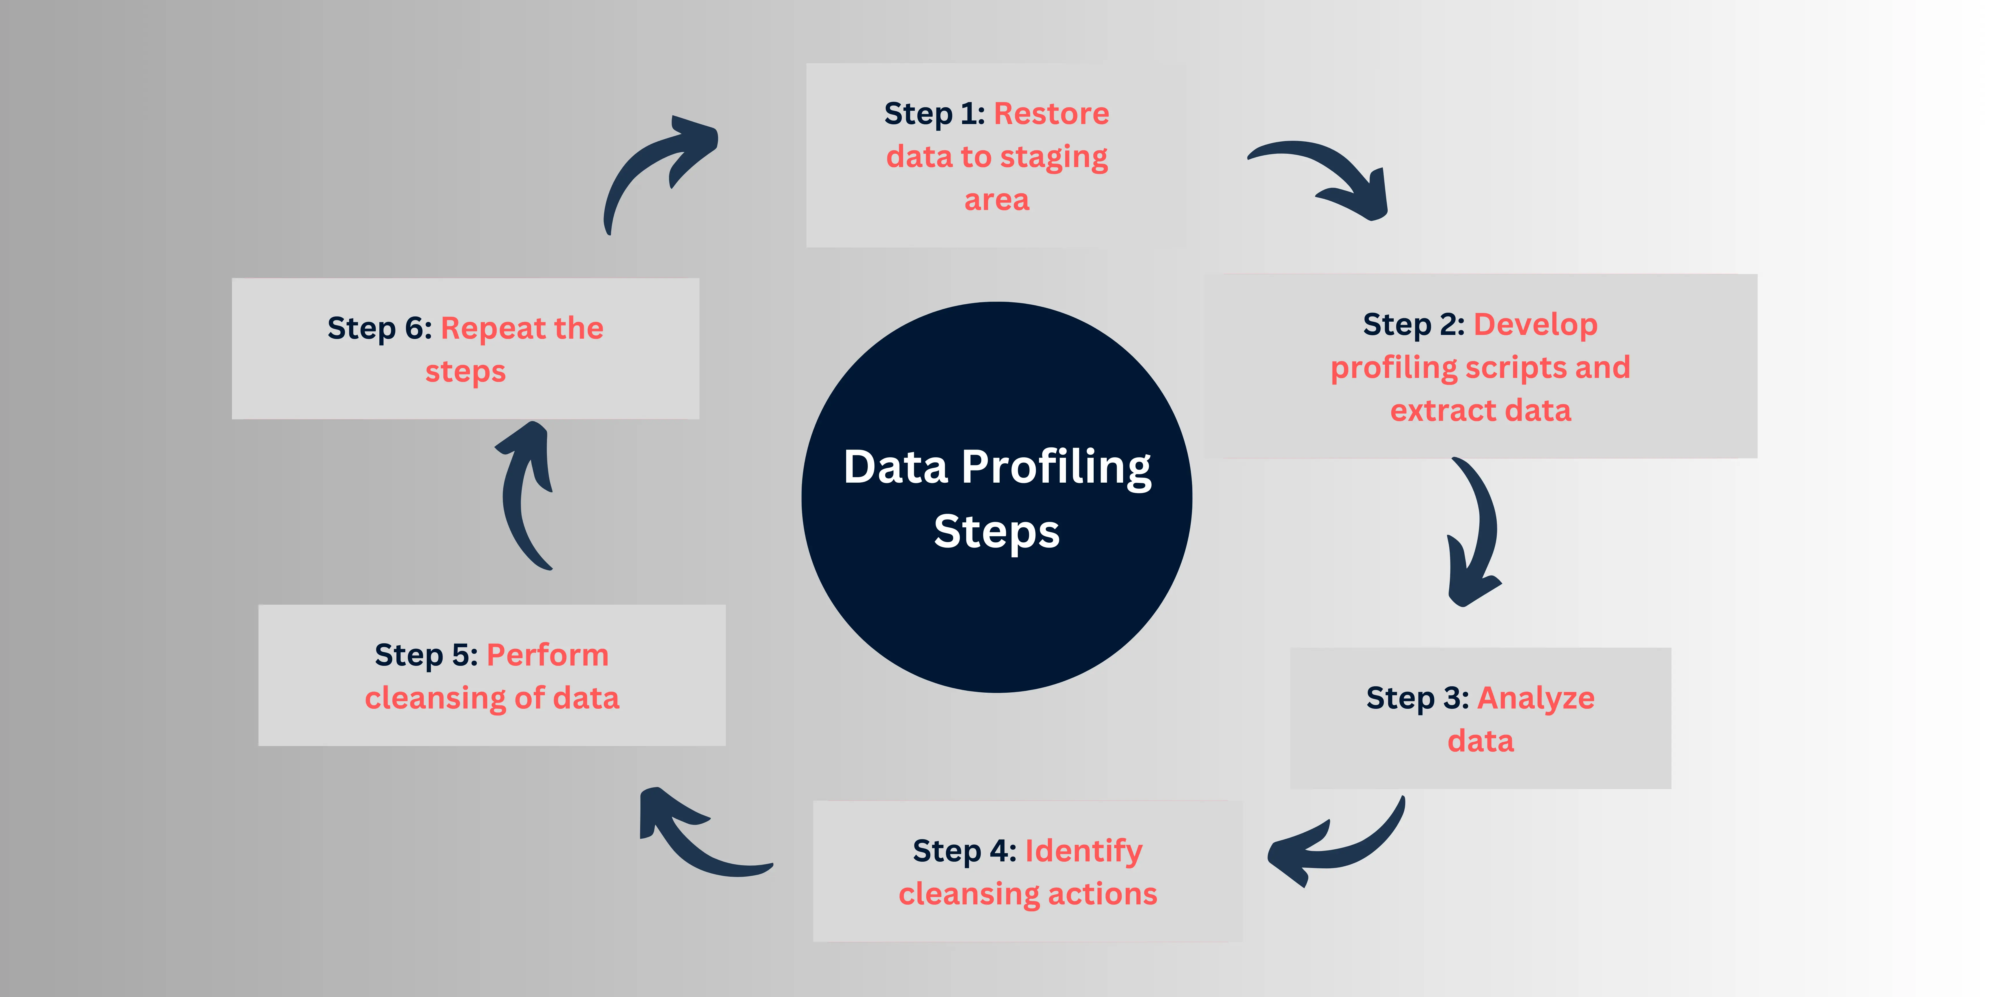
Data Profiling

Slide 40

Data Auditing
Verification of data values against a set of rules or constraints.
Data auditing ensures that data values conform to expected rules and constraints, helping to identify and correct errors.
Examples:
Checking data values against a set of predefined rules
Verifying data values against external sources
Identifying data values that do not conform to expected formats

Slide 41
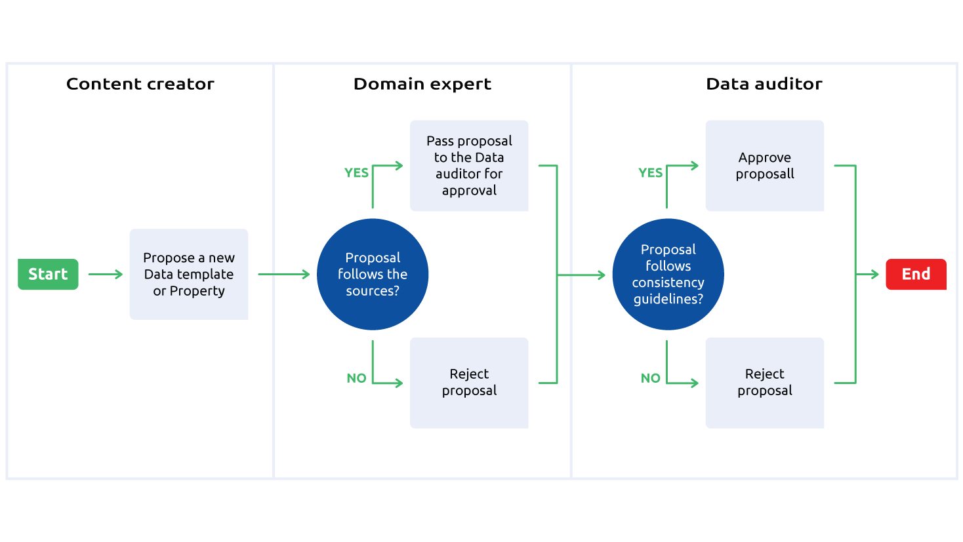
Data Auditing

Slide 42
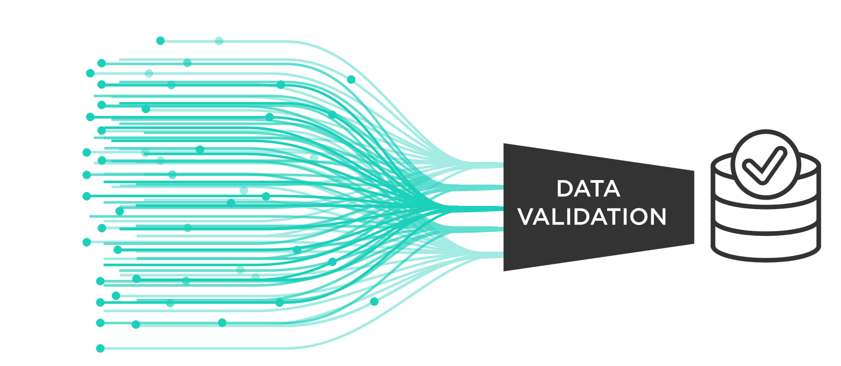
Data Validation
Checking of data values against a set of predefined criteria.
Data validation ensures that data values meet the required criteria, helping to identify and correct errors.
Examples:
Checking data values against a set of predefined formats
Verifying data values against a set of business rules
Identifying data values that do not conform to expected criteria

Slide 43
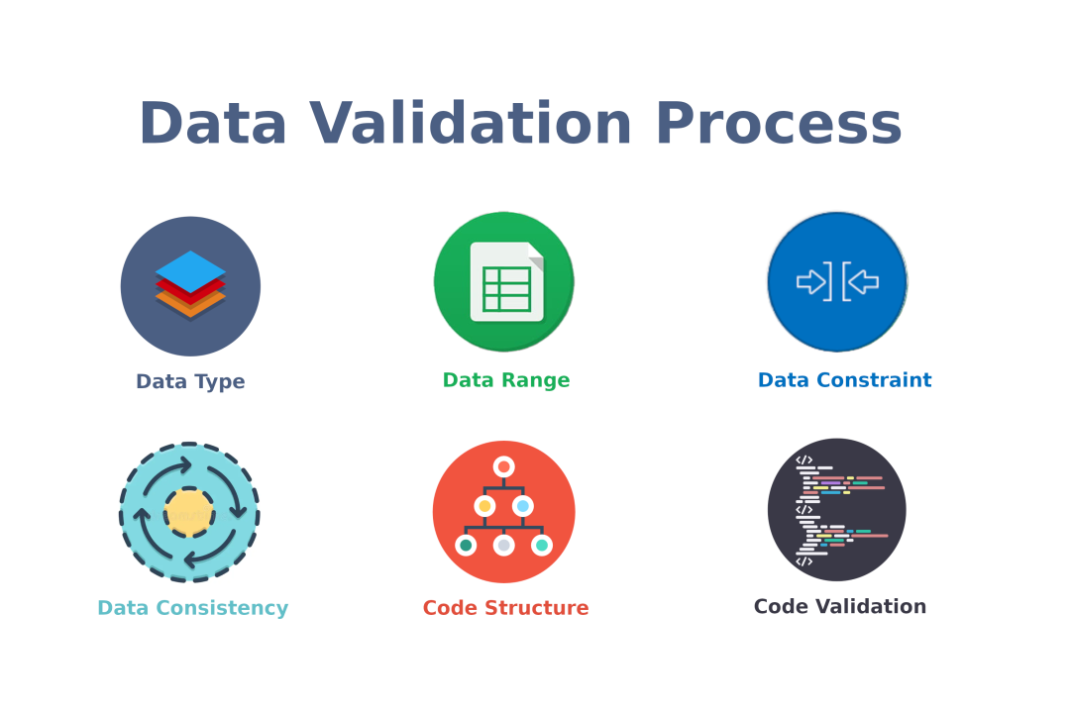
Data Validation

Slide 44
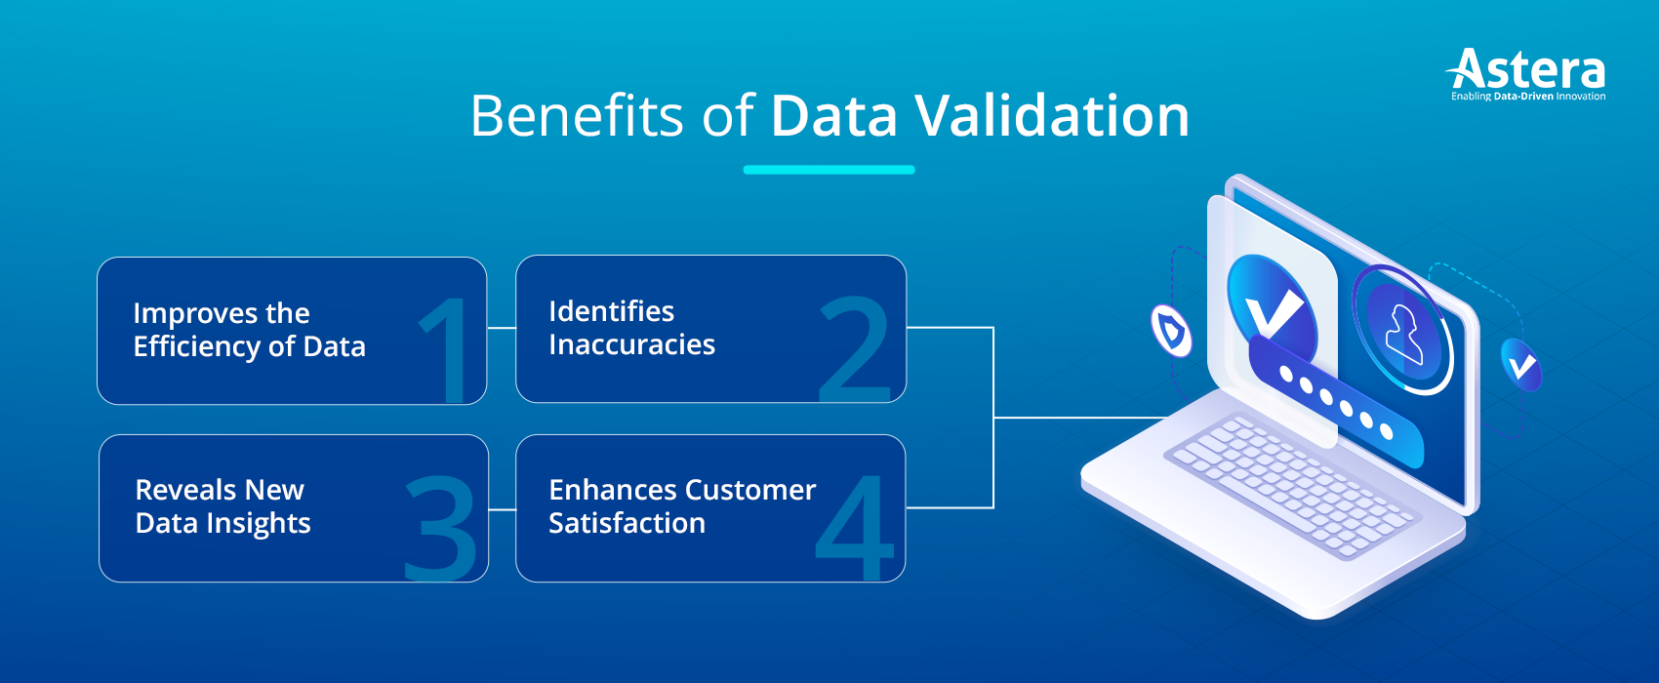
Data Validation

Slide 45
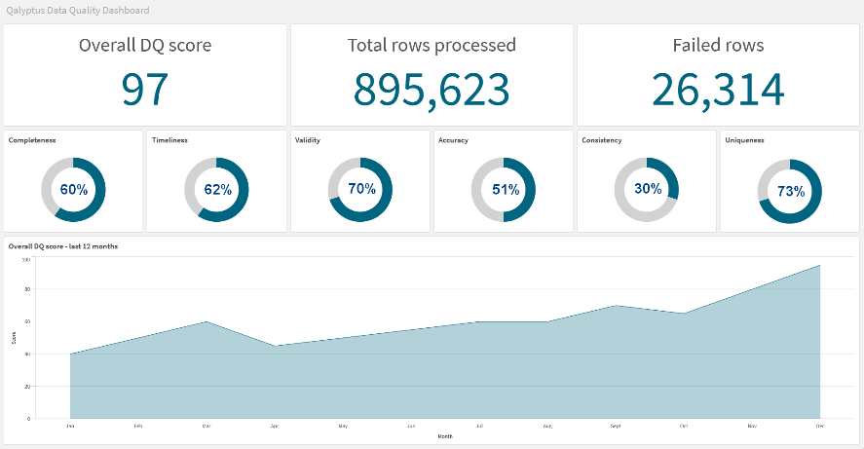
Data Quality Dashboards
Visual representations of data quality metrics and trends.
Data quality dashboards provide a visual representation of data quality, helping to identify issues and opportunities for improvement.
Examples:
Dashboards showing data quality metrics such as accuracy and completeness
Dashboards showing data quality trends over time
Dashboards providing alerts and notifications for data quality issues

Slide 46
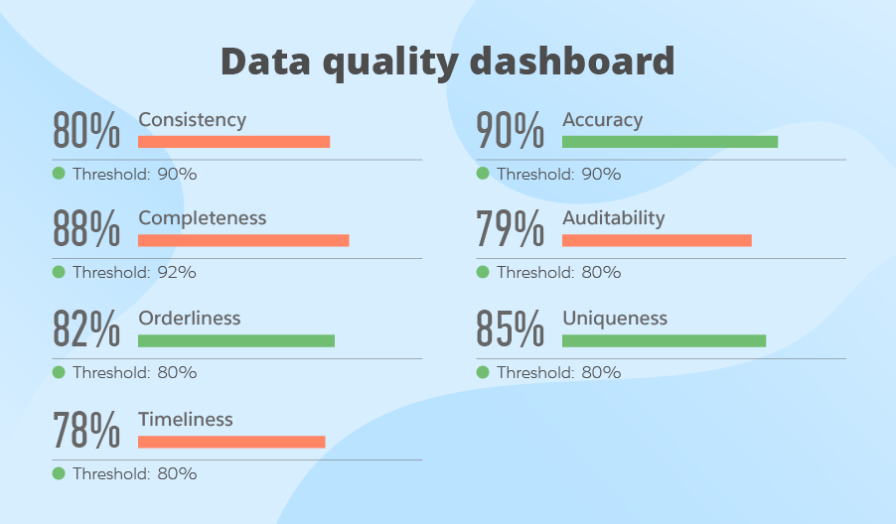
Data Quality Dashboards

Slide 47
Data Quality Assessment
Benefits of Data Quality Assessment
Improved data quality
Increased confidence in data-driven decisions
Better data management and governance
Enhanced data analytics and insights
Challenges of Data Quality Assessment
Defining and selecting relevant metrics
Collecting and analyzing data
Interpreting and communicating results
Maintaining and updating assessments over time

Slide 48




Data Quality Assessment Tools
Examples:
Data profiling tools such as IBM InfoSphere QualityStage
Data auditing tools such as SAP Data Services
Data validation tools such as Talend Data Quality
Data quality dashboards such as Tableau

Slide 49
Best Practices for Data Quality Assessment
Define clear goals and objectives
Select relevant metrics and tools
Collect and analyze data regularly
Communicate results effectively
Continuously monitor and improve

Slide 50
Data Quality Improvement

Slide 51
Enhancing the Quality of Your Data
Data quality improvement is the process of enhancing the quality of your data to make it more accurate, complete, and reliable.
Data cleansing
Data normalization
Data quality rules
Data quality monitoring

Slide 52
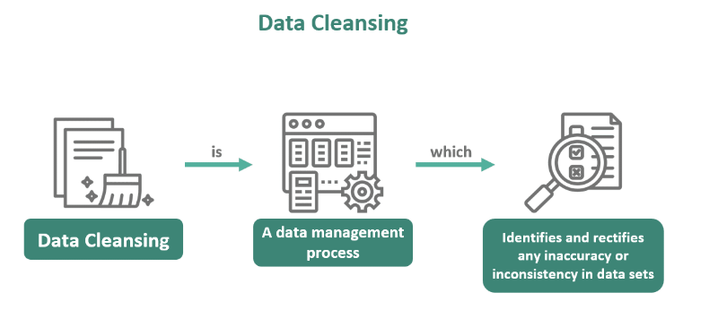
Data Cleansing
Identification and correction of errors, inconsistencies, and inaccuracies in data.
Data cleansing is an essential step in data quality improvement, helping to identify and correct errors and inconsistencies in data.
Examples:
Correcting spelling errors in customer names
Removing duplicate records
Filling in missing values

Slide 53
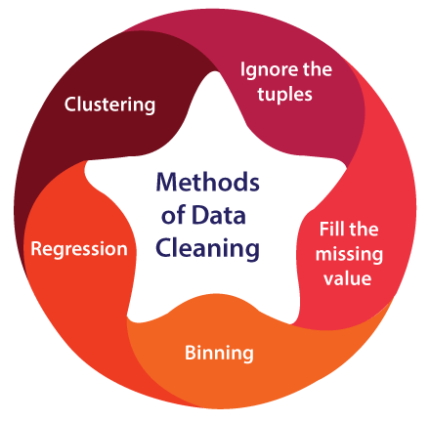
Data Cleansing Techniques
Data scrubbing: removing unnecessary characters or values
Data parsing: breaking down data into smaller components
Data transformation: converting data into a consistent format

Slide 54
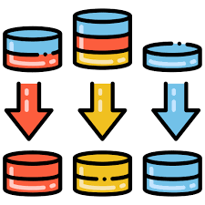
Data Normalization
Transformation of data into a consistent format to improve quality and reduce redundancy.
Data normalization helps to improve data quality by transforming data into a consistent format and reducing redundancy.
Examples:
Standardizing date formats
Aggregating data into a single record
Summarizing data into a concise format

Slide 55
Data Normalization Techniques
Data standardization: applying a consistent format to data
Data aggregation: combining data into a single record
Data summarization: condensing data into a concise format

Slide 56
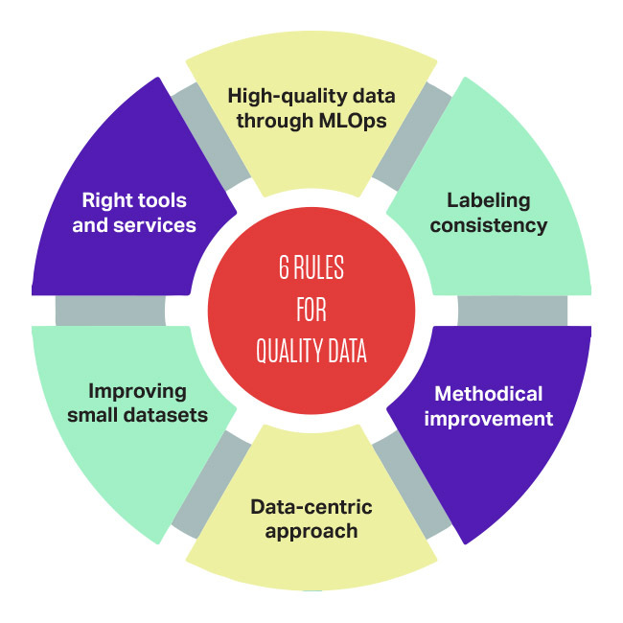
Data Quality Rules
Definition and implementation of rules to prevent data quality issues.
Data quality rules help to prevent data quality issues by defining and implementing rules for data entry, validation, and metrics.
Examples:
Defining rules for data entry
Implementing data validation checks
Establishing data quality metrics

Slide 57
Data Quality Monitoring
Ongoing surveillance of data quality to detect and respond to issues.
Data quality monitoring is an essential step in data quality improvement, helping to detect and respond to data quality issues in real-time.
Examples:
Monitoring data quality metrics
Detecting data quality issues
Responding to data quality issues

Slide 58
Data Quality Improvement
Benefits of Data Quality Improvement
Improved data accuracy
Increased confidence in data-driven decisions
Better data management and governance
Enhanced data analytics and insights
Challenges of Data Quality Improvement
Defining and implementing data quality rules
Collecting and analyzing data quality metrics
Communicating data quality issues to stakeholders
Maintaining and updating data quality improvement processes

Slide 59
Data Cleansing and Normalization Techniques

Slide 60
Improving Data Quality through Data Cleansing and Normalization
Data cleansing and normalization are essential steps in data quality improvement, helping to remove errors, inconsistencies, and inaccuracies from data and transform it into a consistent format.

Slide 61

Data Scrubbing
Removal of incorrect or invalid data values.
Data scrubbing is an essential step in data cleansing, helping to remove errors and inconsistencies from data.
Examples:
Removing invalid email addresses
Correcting spelling errors in customer names
Deleting duplicate records

Slide 62
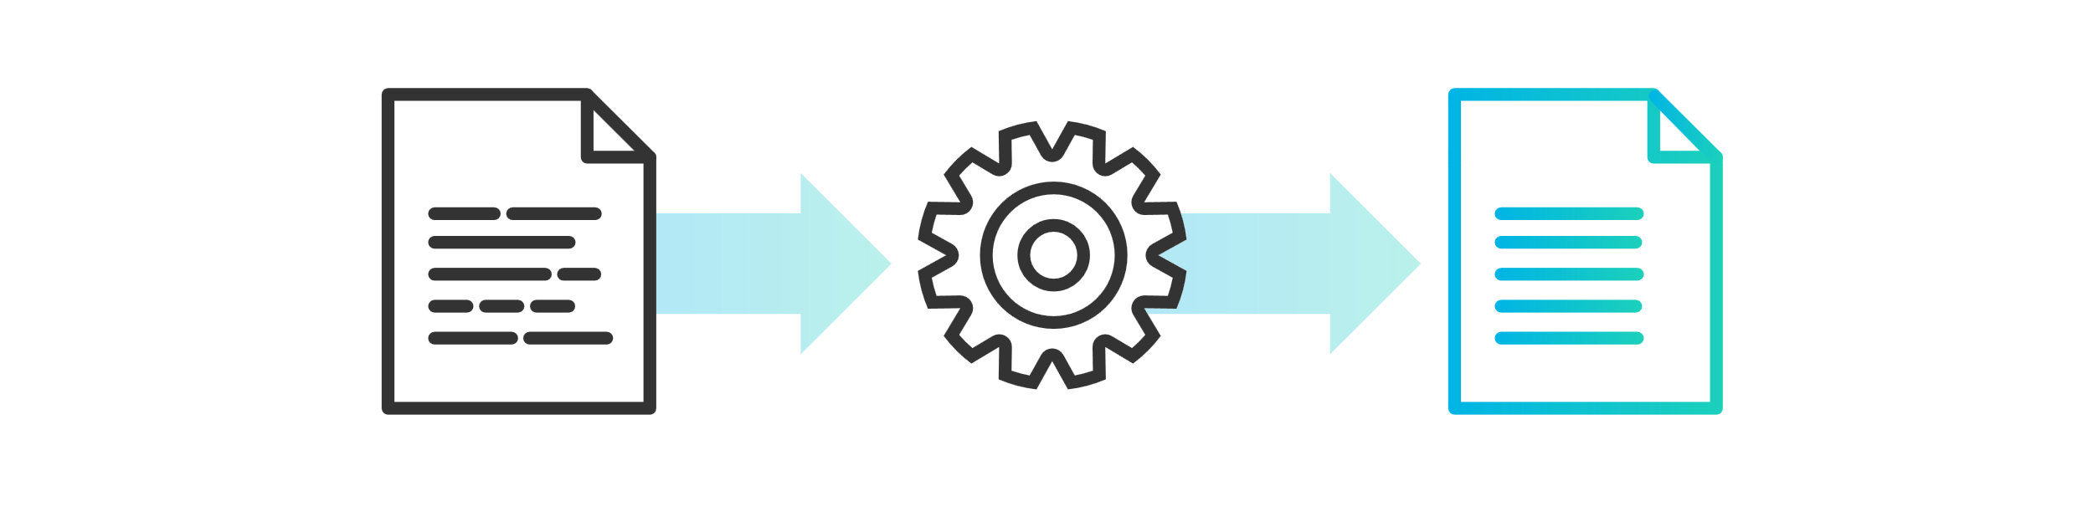
Data Parsing
Extraction of relevant data values from unstructured or semi-structured data.
Data parsing is a technique used to extract relevant data values from unstructured or semi-structured data, helping to improve data quality and reduce errors.
Examples:
Extracting names and addresses from unstructured text
Parsing data from log files
Extracting data from social media posts

Slide 63
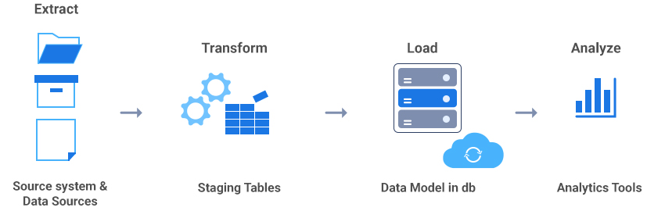
Data Transformation
Conversion of data values from one format to another.
Data transformation is a technique used to convert data values from one format to another, helping to improve data quality and consistency."
Examples:
Converting date formats from MM/DD/YYYY to YYYY-MM-DD
Transforming data from one unit of measurement to another
Changing data types from string to integer

Slide 64
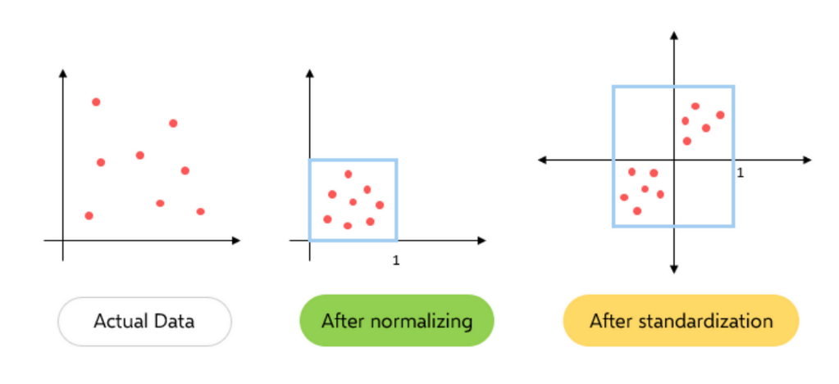
Data Standardization
Application of consistent formatting and coding conventions.
Data standardization is a technique used to apply consistent formatting and coding conventions, helping to improve data quality and reduce errors.
Examples:
Standardizing date formats across a database
Applying consistent coding conventions for data values
Using standardized data formats for data exchange

Slide 65
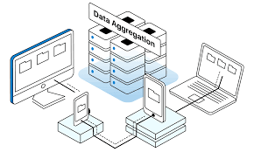
Data Aggregation
Combination of data values to reduce redundancy and improve quality.
Data aggregation is a technique used to combine data values to reduce redundancy and improve quality, helping to improve data management and analysis.
Examples:
Combining data from multiple sources into a single record
Aggregating data to reduce redundancy and improve quality
Creating summary tables to reduce data volume

Slide 66
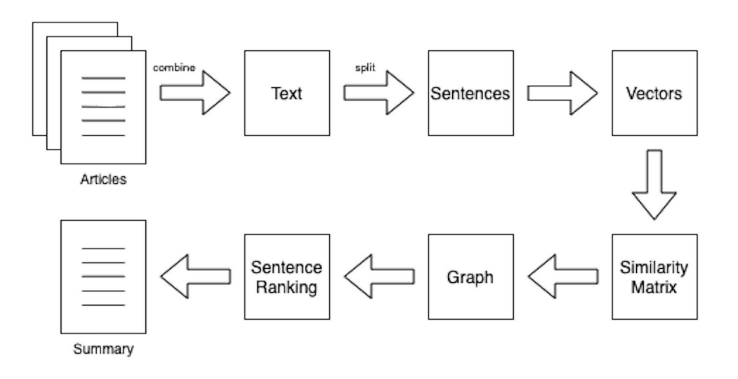
Data Summarization
Reduction of data values to a more compact form.
Data summarization is a technique used to reduce data values to a more compact form, helping to improve data analysis and decision-making.
Examples:
Creating summary reports to reduce data volume
Summarizing data to improve analysis and decision-making
Reducing data complexity through summarization

